Slide 1
Final Video Project
By: Lauren Scott, Landen Nealy, Rhett Ryan, Chance Carroll

Slide 2
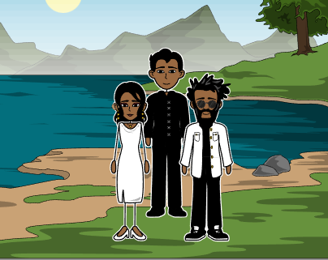
David secretly got married to linda.

Slide 3
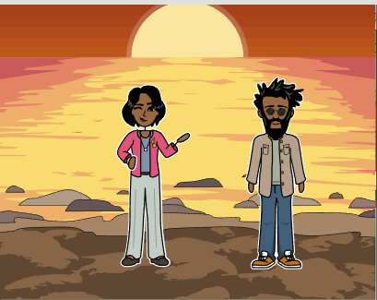
https://anchor.fm/lauren296/episodes/Finallll-e1s5tlc

Slide 4
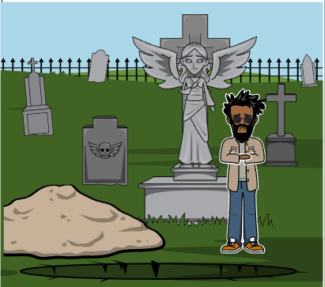

Slide 5
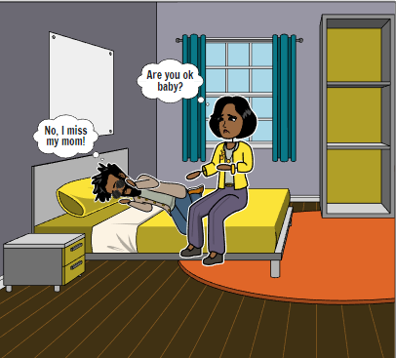

Slide 6
